Slide 1
A First Book of ANSI C Fourth Edition
Chapter 12
Structures

Slide 2
Objectives
Single Structures
Arrays of Structures
Passing and Returning Structures
Unions (Optional)
Common Programming and Compiler Errors

Slide 3
Introduction
Each data item listed in Figure 12.1 is an entity by itself, called a data field
Together, all the data fields form a single unit called a record
In C, a record is referred to as a structure

Slide 4
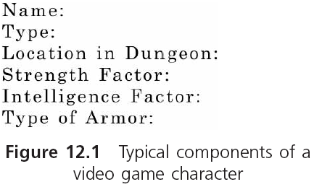
Introduction (continued)

Slide 5
Introduction (continued)
A structure’s form consists of the symbolic names, data types, and arrangement of individual data fields in the record
The structure’s contents consist of the actual data stored in the symbolic names

Slide 6
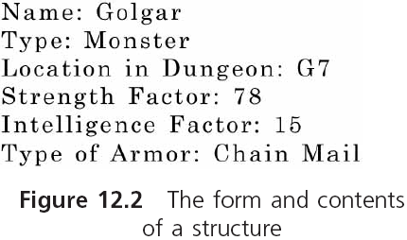
Introduction (continued)

Slide 7
Single Structures
Structure definition in C:
struct
{
int month;
int day;
int year;
} birth;
Reserves storage for the individual data items listed in the structure
The three data items are the members of the structure
Assigning actual data values to the data items of a structure is called populating the structure

Slide 8
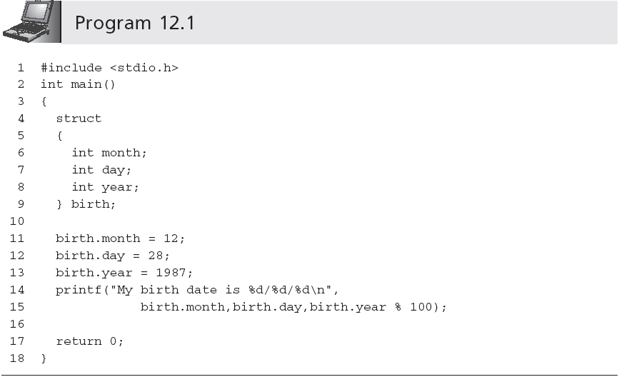
Single Structures (continued)
spacing of a structure definition is not rigid

Slide 9
Single Structures (continued)
Multiple variables can be defined in one statement
struct {int month; int day; int year;} birth, current;
Common to list the form of the structure with no following variable names
The list of structure members must be preceded by a user-selected structure type name
struct Date
{
int month;
int day;
int year;
};

Slide 10
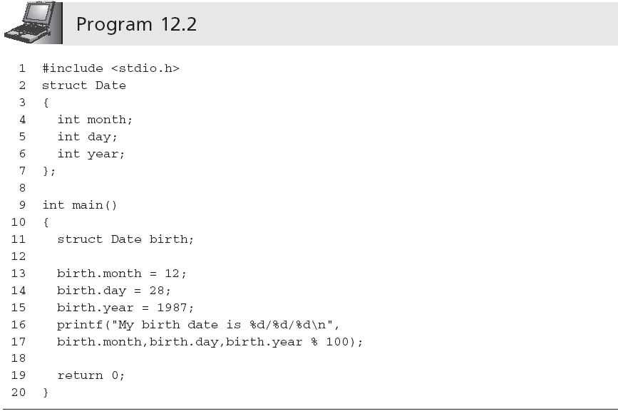
Single Structures (continued)
By convention the first letter of user-selected structure type names is uppercase

Slide 11
Single Structures (continued)
Initialization of structures follows the same rules as for the initialization of arrays:
struct Date birth = {12, 28, 1987};
Structure members can be of any data type
struct PayRecord
{
char name[20];
int idNum;
double regRate;
double otRate;
};
struct PayRecord employee = {"H. Price", 12387, 15.89, 25.50};

Slide 12
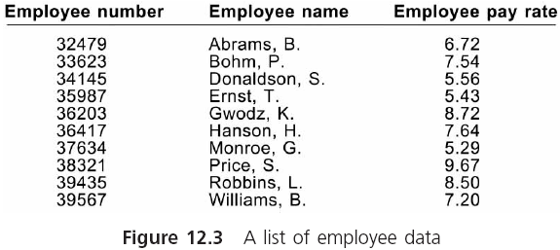
Arrays of Structures

Slide 13
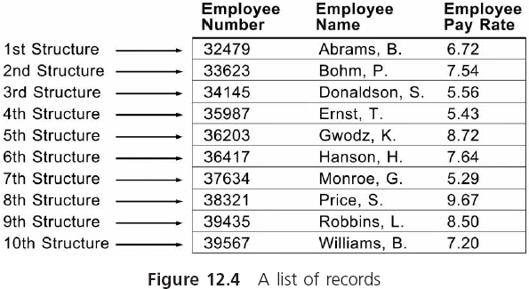
Arrays of Structures (continued)

Slide 14
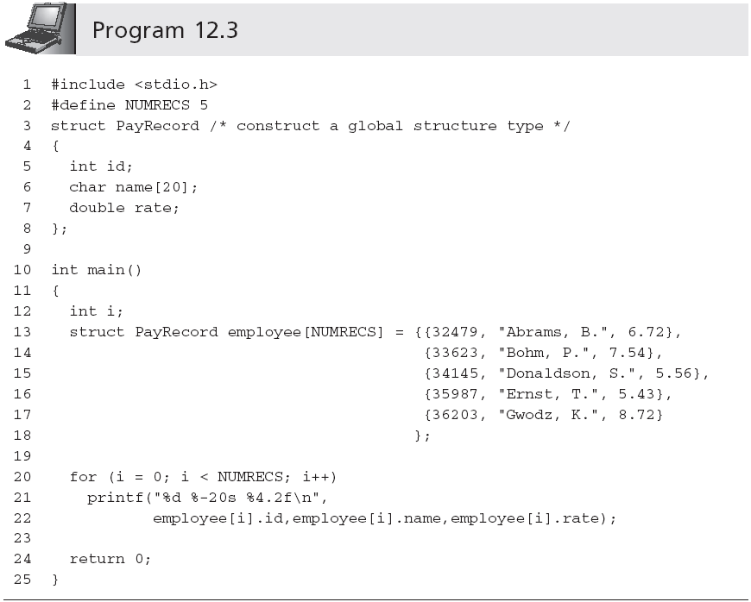
Arrays of Structures (continued)
Inner braces are not necessary

Slide 15
Arrays of Structures (continued)
Without explicit initializers, the numeric elements of both static and external arrays or structures are initialized to 0 (or nulls)
An inferior alternative to an array of structures is parallel arrays
Parallel arrays are two or more arrays, where each array has the same number of elements and the elements in each array are directly related by their position in the arrays
They are rarely used any more

Slide 16
Passing and Returning Structures
Individual structure members may be passed to a function in the same manner as any scalar variable
display(emp.idNum)
calcPay(emp.payRate,emp.hours);
On most compilers, complete copies of all members of a structure can also be passed to a function by including the name of the structure as an argument to the called function
calcNet(emp);

Slide 17
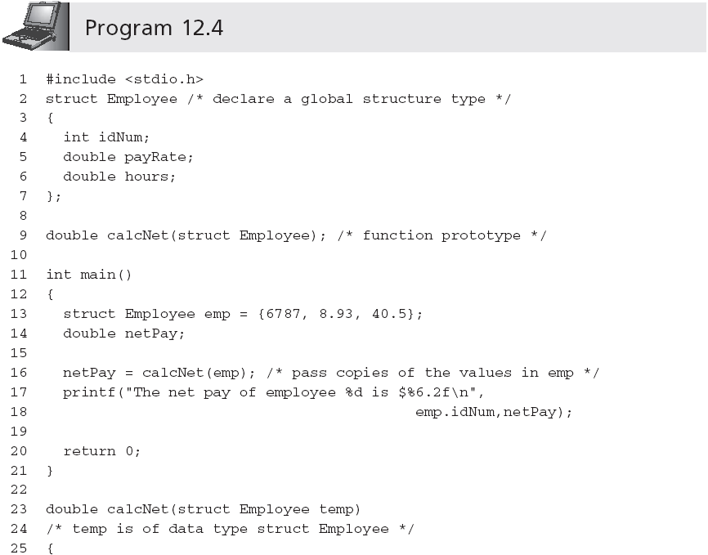
Passing and Returning Structures (continued)
Although the structures in main() and calcNet()
use the same globally defined structure type,
this is not strictly necessary (although it is preferable)
Pass by value

Slide 18
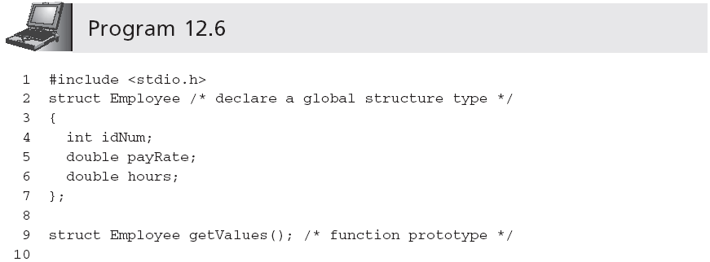
Returning Structures

Slide 19
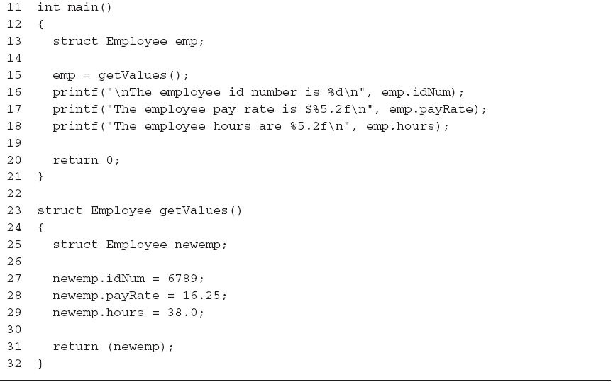
Returning Structures (continued)

Slide 20
Summary
A structure allows individual variables to be grouped under a common variable name
A structure type name can be used to create a generalized structure type describing the form and arrangement of elements in a structure
Structures are particularly useful as elements of arrays

Slide 21
Summary (continued)
Individual members of a structure are passed to a function in the manner appropriate to the data type of the member being passed
Structure members can be any valid C data type, including structures, unions, arrays, and pointers
Unions are declared in the same manner as structures

